Slide 1
Appropriating social media
Public engagement with science and technology online

Slide 2
Overview
Introductions
Social Media Quiz
Discussion
  Getting involved in a national debate
  Engaging with complex research
  Responding to unanticipated media attention
  Engaging communities to support projects
Issues and practical strategies

Slide 3
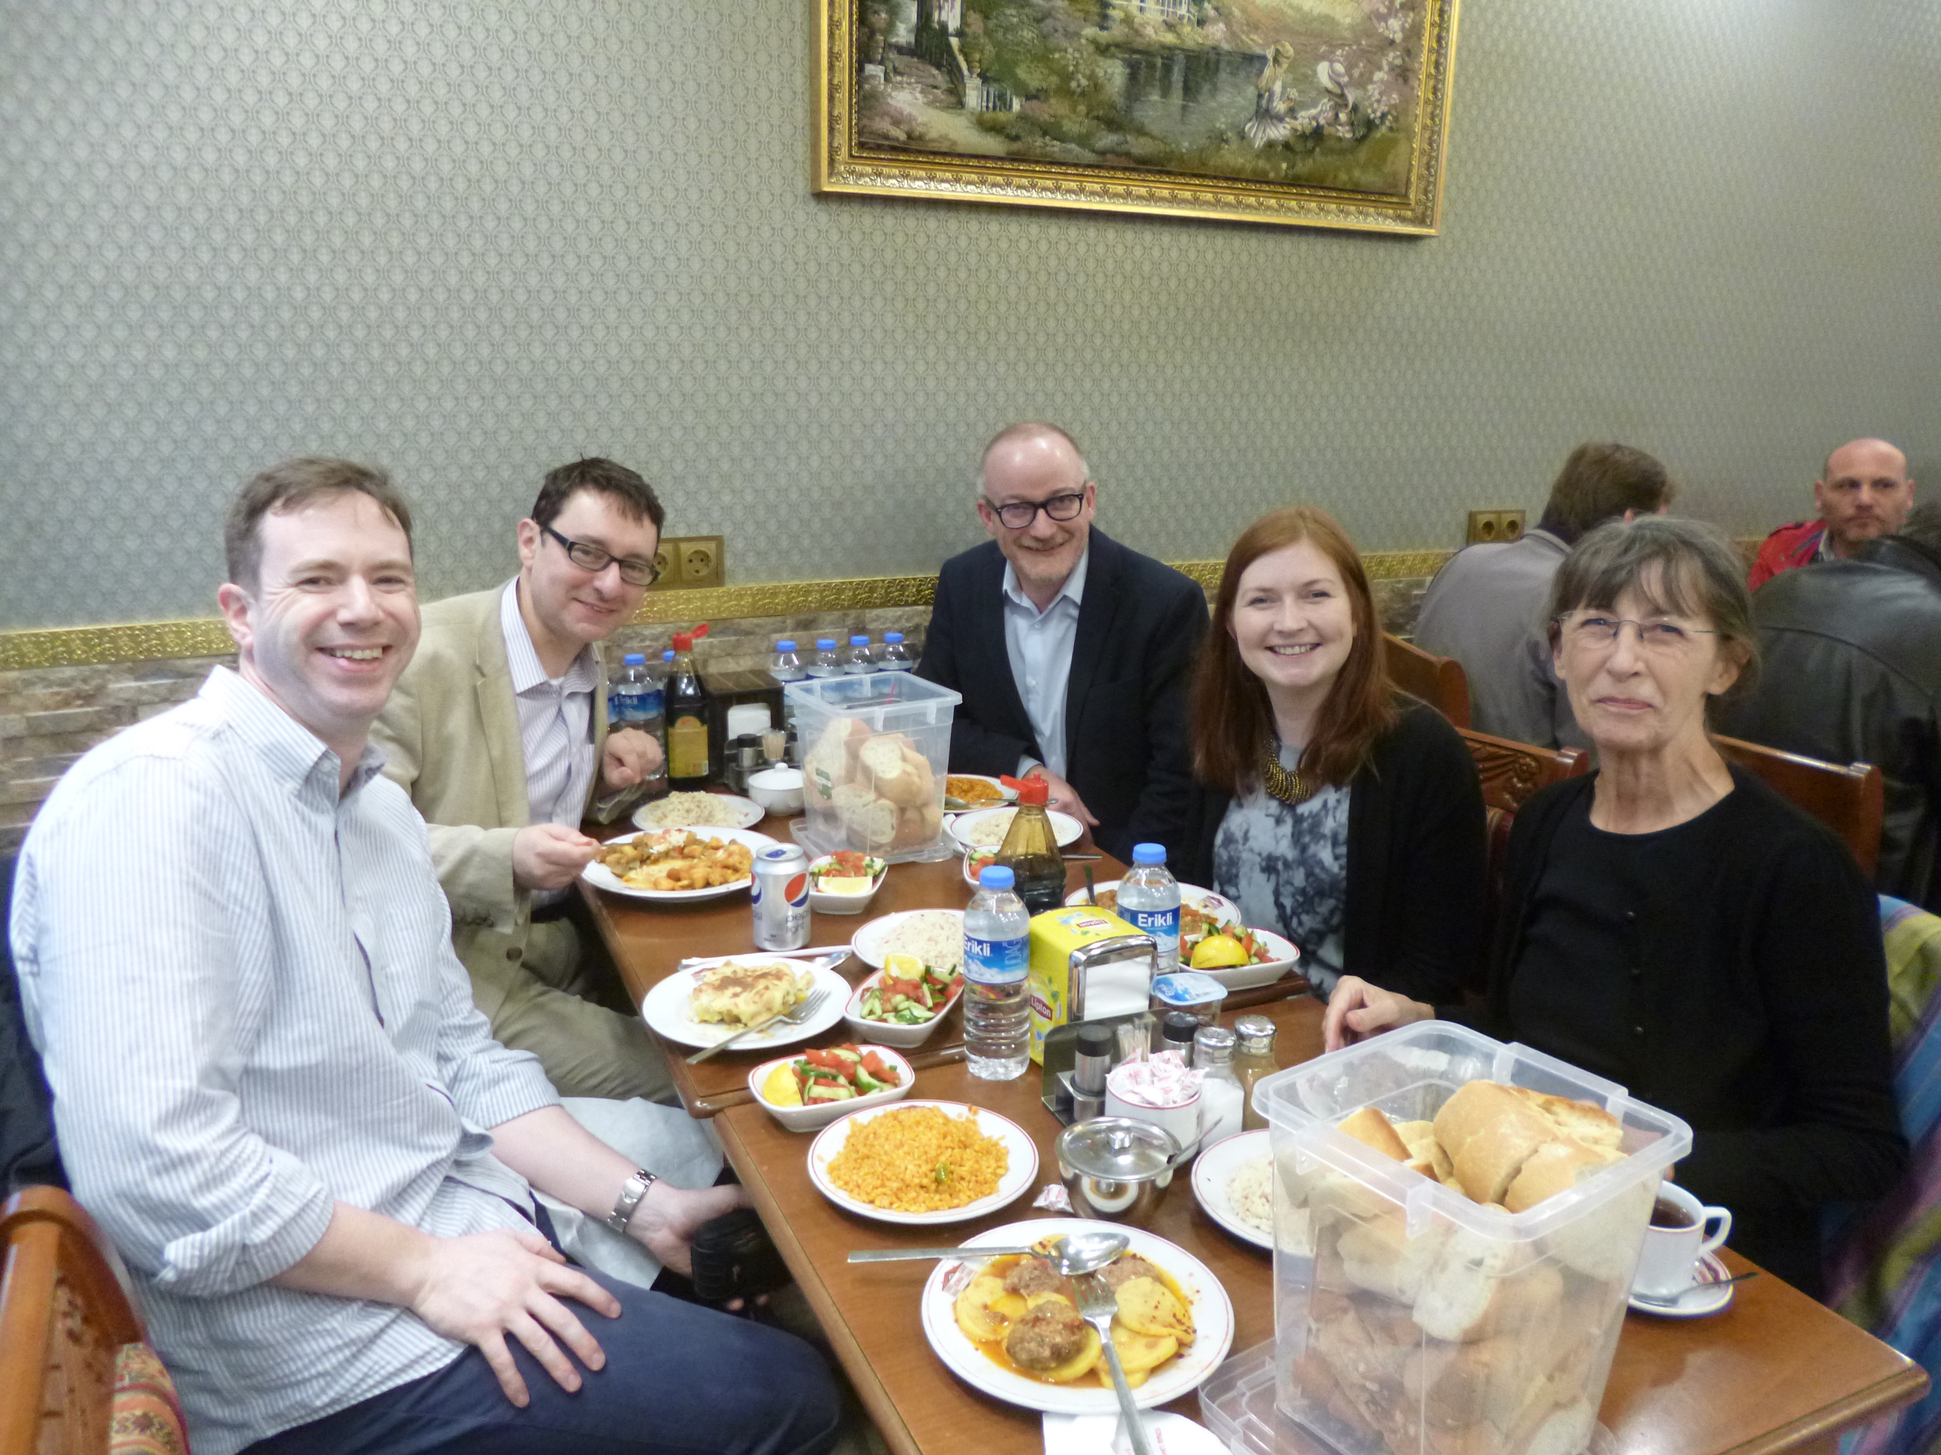
Introductions
Trevor Collins¹, Ken Skelton², Rick Holliman¹, Heather Doran², Ann Grand³ and (Jamie Dorey¹)
1. The Open University, UK
2. The University of Aberdeen, UK
3. The University of Western Australia

Slide 4
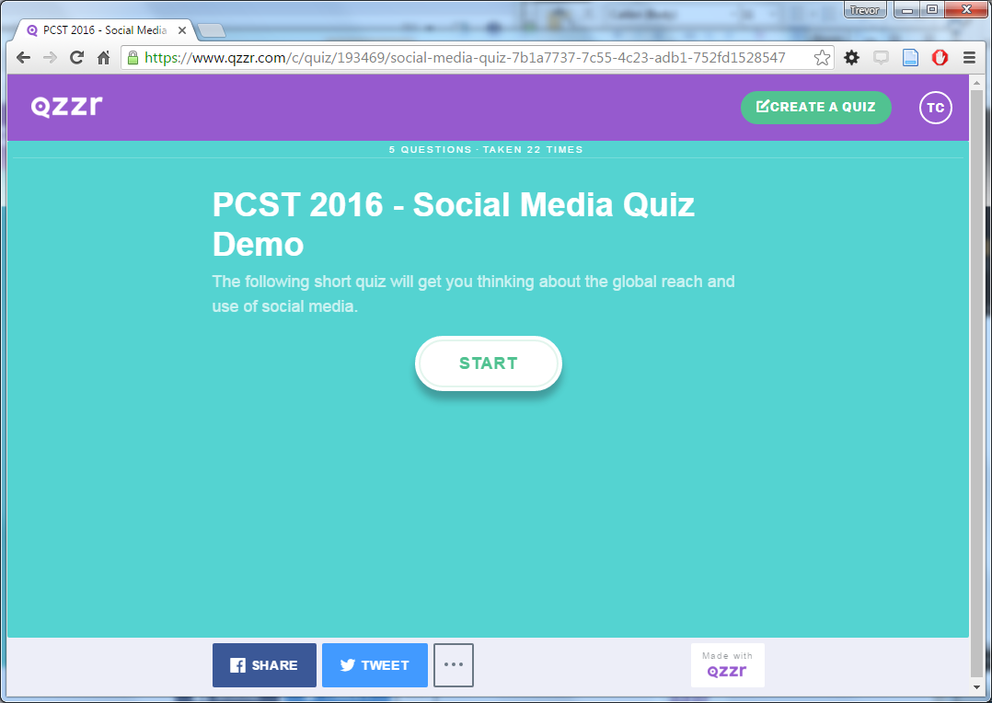
Social Media Quiz
https://goo.gl/iMkTli

Slide 5
Discussion
Getting involved in a national debate (Ken)
Engaging with complex research (Rick)
Responding to unanticipated media attention (Ann)
Engaging communities to support projects (Heather)

Slide 6
practical strategies

